Slide 1



CSA0810-python programming-Slot B
Daily Astrology Comments for All Moon Signs
Guided by:
T. Vincent Gnanaraj
(Course Faculty)
Python Programming
Saveetha school of engineering
Workdone by:
Suthesan .VJ
192210542
computer science engineering
saveetha school of engineering

Slide 2
INTRODUCTION
Astrology, type of divination that involves the forecasting of earthly and human events through the observation and interpretation of the fixed stars, the Sun, the Moon, and the planets.
Astrology is a method of predicting mundane events based upon the assumption that the celestial bodies—particularly the planets and the stars considered in their arbitrary combination.
The purpose of astrology was to inform the individual of the course of his life on the basis of the positions of the planets and zodiacal signs at the moment of his birth or conception.
Aries, Taurus, Gemini, Cancer, Leo, Virgo, Libra, Scorpio, Sagittarius, Capricorn, Aquarius, and Pisces.

Slide 3
ABSTRACT
This program, built using Python and Tkinter, introduces a fun and interactive experience for users seeking daily astrology insights based on their moon signs. The application features a simple graphical user interface with a dropdown menu for selecting moon signs, a button to generate personalized comments, and a display area for presenting the astrology insights. The comments, randomly selected from a diverse pool, cover a range of topics from personal growth to career guidance. The program's modular design allows for easy expansion and potential integration with real-time astrological data or additional features
key words:
python Tkinter, GIU, dropdown, comments, astrological data

Slide 4
HARDWARE AND SOFTWARE REQUIREMENTS
HARDWARE: Processo:r11th Gen Intel(R) Core(TM) i5-11400F @ 2.60GHz 2.59 GHz
System type:64-based processor
RAM:16.0 GB (15.9 GB usable)
GPU:NVIDIA GeForce GT 1030
SOFTWARE: OS:Windows 11 64 bit,
Editor:IDLE,Spyder,etc..
SDK:Python 3.11 version 6

Slide 5
EXISTING SYSTEM
In the existing astrology system, users commonly receive generic daily horoscopes that are not specific to their moon signs.
For instance, a user with a Taurus moon sign might receive the same horoscope as someone with a Sagittarius moon sign.
This lack of personalization often leads to less accurate and meaningful astrological guidance, as the insights are not tailored to the individual characteristics associated with each moon sign

Slide 6
PROPOSED SYSTEM
The proposed system is an interactive Astrology Comments GUI program developed using Python and Tkinter.
The purpose of this program is to provide users with personalized daily astrology insights based on their selected moon signs.
Users can easily navigate through the user-friendly interface, choose their moon sign from a dropdown menu, and receive a unique astrology comment by clicking a button.
The system aims to offer a simple, engaging, and fun experience, adding a touch of astrological curiosity to users' daily routines.

Slide 7

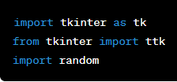
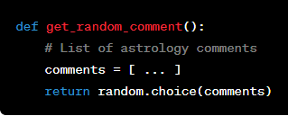

ARCHITECTURE
Importing Libraries
Function to Get Random Astrology Comment:
Tkinter Widget Layout

Slide 8
DESIGN
User Interface Elements:
Moon sign selection combobox.
Button to trigger the generation of a random astrology comment.
Labels for guiding the user and displaying the generated astrology comment.
Functions:
get_random_comment: Selects a random astrology comment from a predefined list.
show_astrology_comment: Retrieves the selected moon sign, generates a random comment, and updates the display.
Tkinter Initialization:
Creation of the main Tkinter window (root).
Setting the window title.

Slide 9
CODE
import tkinter as tk
from tkinter import ttk
import random
def get_random_comment():
comments = ["Reflect on personal growth today.", "Unexpected career opportunities may arise.", # ... (other comments)]
return random.choice(comments)
def show_astrology_comment():
user_moon_sign = moon_sign_combobox.get()
output_text.set(f"\nDaily Astrology Comment for {user_moon_sign}:\n{get_random_comment()}" if user_moon_sign else "Invalid moon sign. Please select a moon sign.")
root = tk.Tk()
root.title("Astrology Comments")
moon_signs = ["Aries", "Taurus", "Gemini", "Cancer", "Leo", "Virgo", "Libra", "Scorpio", "Sagittarius", "Capricorn", "Aquarius", "Pisces"]
moon_sign_combobox = ttk.Combobox(root, values=moon_signs)
submit_button = ttk.Button(root, text="Get Astrology Comment", command=show_astrology_comment)
output_text = tk.StringVar()
output_label = ttk.Label(root, textvariable=output_text)
moon_sign_combobox.pack(pady=10)
submit_button.pack(pady=10)
output_label.pack(pady=10)
root.mainloop()

Slide 10
TESTING APPROACH
Manual Testing:
GUI interaction with dropdown and button.
Validation of valid and invalid moon sign entries.
Random comment generation testing.
Test Cases:
Valid Input: Select "Leo," click to get a comment.
Invalid Input: Leave dropdown empty, attempt to get a comment.
Random Comment: Record Virgo comment, click multiple times for variations.

Slide 11
IMPLEMENTATION
Personal Astrology App
Learning and Practice
Educational Tool
Entertainment at Events
Mobile App
WARNING: This program can be executed only with python 3 portal and already mentioned hardware and software requirements

Slide 12
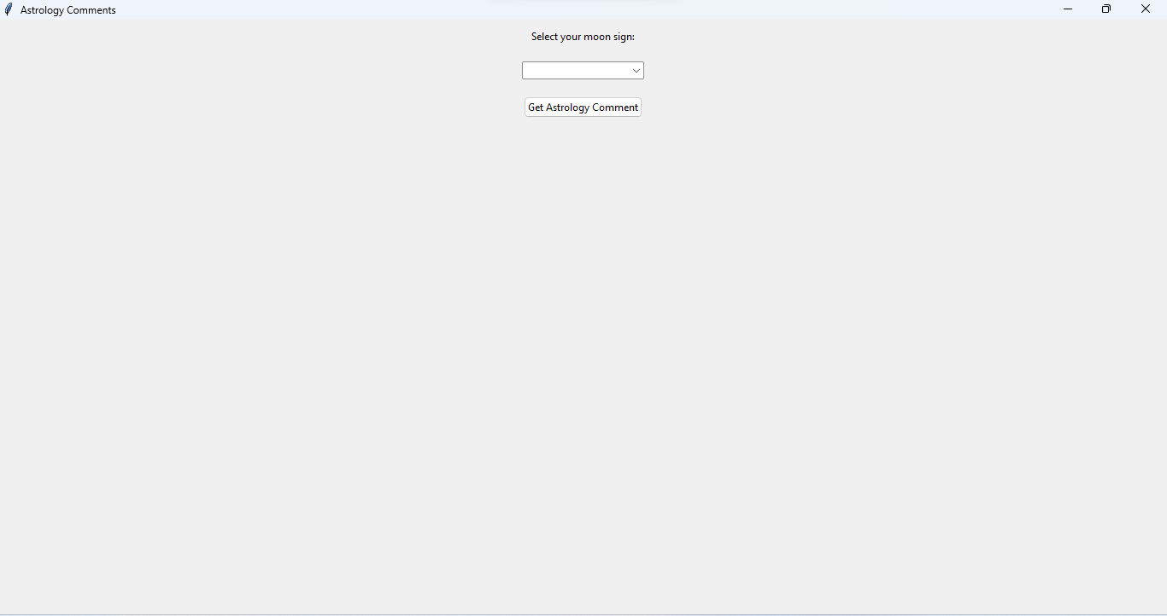
FINAL OUTPUT

Slide 13
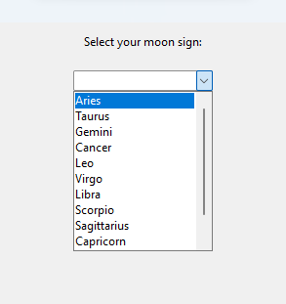
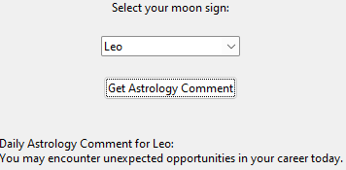
ASTROLOGY COMMENT ACCORDING TO YOUR MOON SIGN
SELECT YOU MOON SIGN

Slide 14
CONCLUSION
In summary, the Astrology Comments GUI program, developed with Python and Tkinter, offers a quick and engaging way for users to receive personalized daily astrology insights based on their selected moon signs. The program's simplicity and user-friendly design make it suitable for various applications, from personal use to learning and entertainment. With room for potential enhancements, the program provides a fun and interactive experience, showcasing the versatility of Python for creating straightforward yet impactful graphical user interfaces.

Slide 15
FUTURE SCOPE
Enhance the program by integrating with astrology APIs to provide real-time and dynamic astrological data, ensuring up-to-date and accurate insights.
Implement user profiles to store individual preferences, allowing for a more personalized and tailored astrology experience over time.
Expand the program to include features such as sun signs, rising signs, and planetary alignments for a more comprehensive astrological analysis.
Introduce a notification system to deliver daily astrology comments directly to users, creating a seamless and integrated experience.

Slide 16
REFERENCE
Lehoux, Daryn. "Observation and prediction in ancient astrology." Studies in History and Philosophy of Science Part A 35.2 (2004): 227-246. https://www.sciencedirect.com/science/article/pii/S0039368103000955
Amos, David. "Python gui programming with tkinter." Real Python (2020).
https://techcbse.com/wp-content/uploads/2021/07/wp-1626189082051.pdf
Moore, Alan D. Python GUI Programming with Tkinter: Develop responsive and powerful GUI applications with Tkinter. Packt Publishing Ltd, 2018.
https://accelconf.web.cern.ch/pcapac2016/papers/wepoprpo25.pdf
Tester, S. Jim. A history of western astrology. Boydell & Brewer, 1987.
https://books.google.com/books?hl=en&lr=&id=L0HSvH96alIC&oi=fnd&pg=PR6&dq=astrology&ots=vVC78dFDeY&sig=pcMPif0eQIZtvTcr4K_I8y9UFC0

Slide 17
Thank you for listening!

